Slide 1
The Z-Transformation
Exercise-8.1
(Part-1)

Slide 2
Objective
Solving some problems on Z-transformation
Methodologies:
The formulae of Z-transformation will be used

Slide 3

Problem(i):$Evaluate Z\left\{\left(n+1\right)u\left[n\right]\right\}.$
Solution: $Z\left\{\left(n+1\right)u\left[n\right]\right\}$
$$=Z\left\{n u\left[n\right]+u\left[n\right]\right\}$$
$=\frac{z}{{\left(z−1\right)}^{2}}+\frac{z}{z−1}$ ROC: $\left|z\right|>1$
$=\frac{z^{2}}{{\left(z−1\right)}^{2}}$ ROC: $\left|z\right|>1.$
Problem(ii):$Evaluate Z\left\{2^{n}u\left[n\right]\right\}.$
Solution: $Z\left\{2^{n}u\left[n\right]\right\}=\frac{1}{1−2z^{−1}}$ or, $\frac{z}{z−2} for \left|z\right|>2$.
Problem(iii):$Evaluate Z\left\{{\left(−\frac{1}{3}\right)}^{n}u\left[n\right]\right\}.$
Solution: $Z\left\{{\left(−\frac{1}{3}\right)}^{n}u\left[n\right]\right\}=\frac{1}{1−\left(−\frac{1}{3}\right)z^{−1}}=\frac{1}{1+\frac{1}{3}z^{−1}}$ or, $\frac{z}{z+\frac{1}{3}}=\frac{3z}{3z+1} for \left|z\right|>\frac{1}{3}$.

Slide 4

Problem(iv): Evaluate $Z\left\{δ\left[n−3\right]\right\}$.
Solution: $Z\left\{δ\left[n−3\right]\right\}=z^{−3}$ for all z.
Problem(v): Evaluate $Z\left\{δ\left[n+2\right]\right\}$
Solution: $Z\left\{δ\left[n+2\right]\right\}=z^{2}$ for all z.
Problem(vi): Evaluate $Z\left\{10\right\} for n≥0$.
Solution: $Z\left\{10\right\}=\frac{10}{1−z^{−1}}$, since $u\left[n\right]=1 for n≥0.$
Problem(vii): Evaluate $Z^{−1} \left\{5\right\}.$
Solution: $Z^{−1} \left\{5\right\}=5δ\left[n\right].$
Problem(viii): Evaluate $Z^{−1}\left\{\frac{1}{1+\frac{1}{2}z^{−1}}\right\}, for \left|z\right|>\frac{1}{2}$.
Solution: $Z^{−1}\left\{\frac{1}{1+\frac{1}{2}z^{−1}}\right\}=Z^{−1}\left\{\frac{1}{1−\left(−\frac{1}{2}\right)z^{−1}}\right\}={\left(−\frac{1}{2}\right)}^{n}u\left[n\right]$.

Slide 5

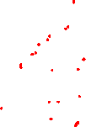
Problem(ix): Evaluate $Z^{−1}\left\{\frac{1}{1−3z^{−1}}\right\}$ for $\left|z\right|>3$.
Solution: $Z^{−1}\left\{\frac{1}{1−3z^{−1}}\right\}=3^{n}u\left[n\right]$.
Problem(x): Evaluate $Z^{−1}\left\{\frac{1+z^{−1}}{1−z^{−2}}\right\}, \left|z\right|>1$.
Solution: $Z^{−1}\left\{\frac{1+z^{−1}}{1−z^{−2}}\right\}=Z^{−1}\left\{\frac{1+z^{−1}}{\left(1+z^{−1}\right)\left(1−z^{−1}\right)}\right\}=Z^{−1}\left\{\frac{1}{1−z^{−1}}\right\}=u\left[n\right]$.
Problem(xi): Evaluate $Z^{−1}\left\{\frac{1+4z^{−1}}{1−{2z}^{−1}}\right\}, \left|z\right|>2$.
Solution: $Z^{−1}\left\{\frac{1+4z^{−1}}{1−{2z}^{−1}}\right\}$= $Z^{−1}\left\{\frac{−2(1−2z^{−1})+3}{1−{2z}^{−1}}\right\}$
$=Z^{−1}\left\{−2+\frac{3}{1−2z^{−1}}\right\}$
$=−2δ\left[n\right]+3{∗2}^{n}u\left[n\right]$.
Problem(xii): Evaluate $Z^{−1}\left\{\frac{5}{5−z^{−1}}\right\}, \left|z\right|>\frac{1}{5}$.
Solution: $Z^{−1}\left\{\frac{5}{5−z^{−1}}\right\}=Z^{−1}\left\{\frac{5}{5\left(1−\frac{1}{5}z^{−1}\right)}\right\}={\left(\frac{1}{5}\right)}^{n}u\left[n\right].$

Slide 6
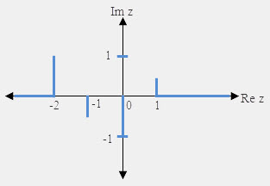

Problem(xiii): Determine the sequence $x\left[n\right]$ with z-transform and hence sketch $x\left[n\right]$.
$X\left(z\right)=z^{2}\left(1−\frac{1}{2}z^{−1}\right)\left(1+z^{−1}\right)\left(1−z^{−1}\right)$
Solution: Given $X\left(z\right)=z^{2}\left(1−\frac{1}{2}z^{−1}\right)\left(1+z^{−1}\right)\left(1−z^{−1}\right)$
$⟹X\left(z\right)=\left(z^{2}−\frac{1}{2}z\right){\left(1−z^{−2}\right)=z}^{2}−\frac{1}{2}z−1+\frac{1}{2}z^{−1}$
$⟹Z^{−1}\left\{X\left(z\right)\right\}=Z^{−1}\left\{z^{2}−\frac{1}{2}z−1+\frac{1}{2}z^{−1}\right\}$
$⇒x\left[n\right]=δ\left[n+2\right]−\frac{1}{2}δ\left[n+1\right]−δ\left[n\right]+\frac{1}{2}δ\left[n−1\right].$
$⇒x\left[n\right]=\left\{\begin{aligned}1, n=−2 \\ −\frac{1}{2}, n=−1 \\ −1, n=0 \\ \frac{1}{2}, n=1 \\ 0, otherwise.\end{aligned}\right.$

Slide 7

Exercises
Evaluate the followings:
$Z\left\{\left(3^{n}+2\right)u\left[n\right]\right\}$
$Z\left\{\left({\left(−1\right)}^{n}+1\right)u\left[n\right]\right\}$
$Z\left\{{\left(−2\right)}^{n}u\left[n\right]\right\}$
$Z\left\{{\left(\frac{2}{3}\right)}^{n}u\left[n\right]\right\}$
$Z\left\{δ\left[n+4\right]\right\}$
$Z\left\{−3\right\}$
$Z^{−1}\left\{\frac{1}{1+\frac{2}{5}z^{−1}}\right\}, for \left|z\right|>\frac{2}{5}$
$Z^{−1}\left\{\frac{1}{2−4z^{−1}}\right\}, \left|z\right|>2$
$Z^{−1}\left\{\frac{1+{\frac{1}{3}z}^{−1}}{1−{\frac{1}{9}z}^{−2}}\right\}, \left|z\right|>1$
$Z^{−1}\left\{\frac{1+2z^{−1}}{1−{2z}^{−1}}\right\}, \left|z\right|>2$
$Z^{−1}\left\{\frac{1−z^{−1}}{1−{az}^{−1}}\right\}, \left|z\right|>\left|a\right|.$
Determine the sequence $x\left[n\right]$ with z-transform and hence sketch $x\left[n\right]$
$$X\left(z\right)=\left(1+2z\right)\left(1+3z^{−1}\right)\left(1−z^{−1}\right).$$

Slide 8
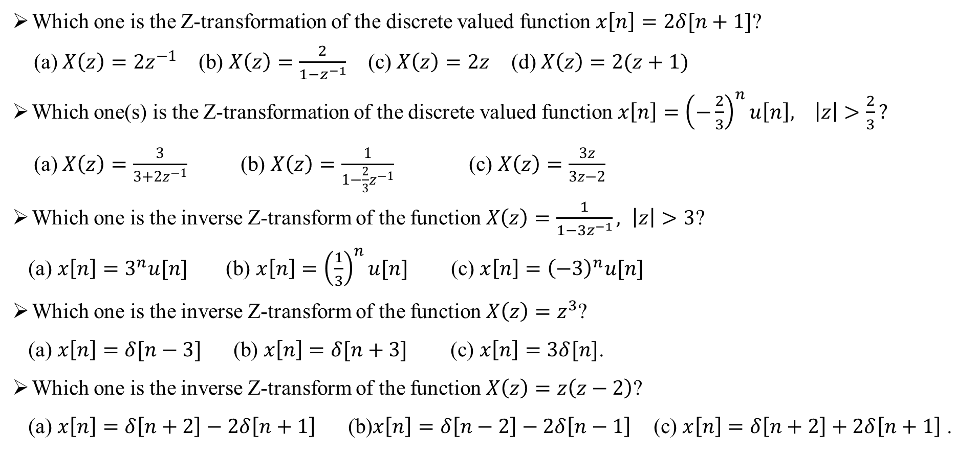
Sample MCQ:
Which one is the Z-transformation of the discrete valued function $x\left[n\right]=2δ[n+1]$?
(a) $X\left(z\right)=2z^{−1}$ (b) $X\left(z\right)=\frac{2}{1−z^{−1}}$ (c) $X\left(z\right)=2z$ (d) $X\left(z\right)=2(z+1)$
Which one(s) is the Z-transformation of the discrete valued function $x\left[n\right]={\left(−\frac{2}{3}\right)}^{n}u\left[n\right], \left|z\right|>\frac{2}{3}?$
(a) $X\left(z\right)=\frac{3}{3+2z^{−1}}$ (b) $X\left(z\right)=\frac{1}{1−\frac{2}{3}z^{−1}}$ (c) $X\left(z\right)=\frac{3z}{3z−2}$
Which one is the inverse Z-transform of the function $X\left(z\right)=\frac{1}{1−3z^{−1}}, \left|z\right|>3$?
(a) $x\left[n\right]=3^{n}u[n]$ (b) $x\left[n\right]={\left(\frac{1}{3}\right)}^{n}u[n]$ (c) $x\left[n\right]={\left(−3\right)}^{n}u[n]$
Which one is the inverse Z-transform of the function$X\left(z\right)=z^{3}$?
(a) $x\left[n\right]=δ[n−3]$ (b) $x\left[n\right]=δ[n+3]$ (c) $x\left[n\right]=3δ[n]$.
Which one is the inverse Z-transform of the function$X\left(z\right)=z\left(z−2\right)$?
(a) $x\left[n\right]=δ\left[n+2\right]−2δ\left[n+1\right]$ (b)$x\left[n\right]=δ\left[n−2\right]−2δ\left[n−1\right]$ (c) $x\left[n\right]=δ\left[n+2\right]+2δ\left[n+1\right]$ .

